Slide 1
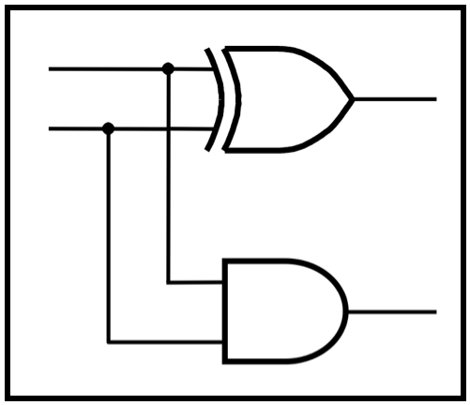
CprE 281:
Digital Logic
Instructor: Alexander Stoytchev
http://www.ece.iastate.edu/~alexs/classes/

Slide 2
Floating Point Numbers
CprE 281: Digital Logic
Iowa State University, Ames, IA
Copyright © Alexander Stoytchev

Slide 3
Administrative Stuff
HW 6 is out
It is due on Monday Oct 10 @ 4pm

Slide 4
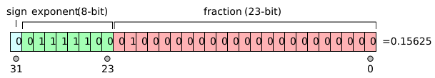
The story with floats is more complicated
IEEE 754-1985 Standard
[http://en.wikipedia.org/wiki/IEEE_754]

Slide 5
In the example shown above, the sign bit is zero, the exponent is 124, and the significand is 1.01 (in binary, which is 1.25 in decimal). The represented number is
(-1)⁰ × 2⁽¹²⁴ ⁻ ¹²⁷⁾ × 1.25 = +0.15625.
[http://en.wikipedia.org/wiki/IEEE_754]

Slide 6
Float (32-bit) vs. Double (64-bit)
32 bits
S
E
M
Sign
0 denotes
+
8-bit
23 bits of mantissa
1 denotes
–
excess-127
exponent
(a) Single precision
64 bits
S
E
M
Sign
11-bit excess-1023
52 bits of mantissa
exponent
(b) Double precision
[Figure 3.37 from the textbook]

Slide 7
On-line IEEE 754 Converter
http://www.h-schmidt.net/FloatApplet/IEEE754.html

Slide 8
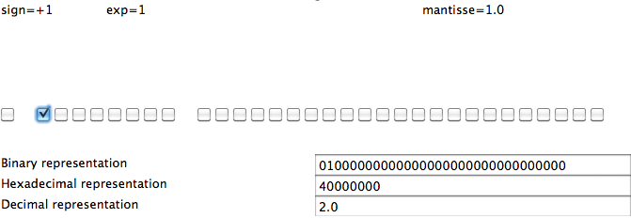
Representing 2.0
[http://www.h-schmidt.net/FloatApplet/IEEE754.html]

Slide 9
Representing 2.0
[http://www.h-schmidt.net/FloatApplet/IEEE754.html]

Slide 10
Representing 2.0
0
128
0
[http://www.h-schmidt.net/FloatApplet/IEEE754.html]

Slide 11
Representing 2.0
(-1)⁰
2⁽¹²⁸⁻¹²⁷⁾
(1 + 0)
[http://www.h-schmidt.net/FloatApplet/IEEE754.html]

Slide 12
Representing 2.0
(-1)⁰
×
2⁽¹²⁸⁻¹²⁷⁾
×
(1 + 0)
= 2.0
[http://www.h-schmidt.net/FloatApplet/IEEE754.html]

Slide 13
Representing 2.0
1
×
2¹
×
1.0
= 2.0
[http://www.h-schmidt.net/FloatApplet/IEEE754.html]

Slide 15
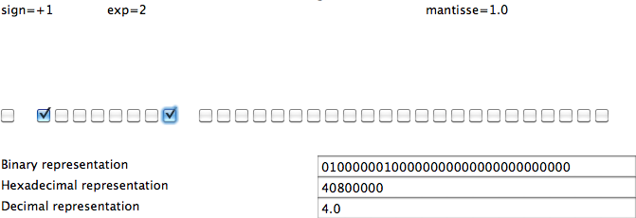
Representing 4.0
[http://www.h-schmidt.net/FloatApplet/IEEE754.html]

Slide 16
Representing 4.0
[http://www.h-schmidt.net/FloatApplet/IEEE754.html]

Slide 17
Representing 4.0
0
129
0
[http://www.h-schmidt.net/FloatApplet/IEEE754.html]

Slide 18
Representing 4.0
(-1)⁰
×
2⁽¹²⁹⁻¹²⁷⁾
×
(1 + 0)
= 4.0
[http://www.h-schmidt.net/FloatApplet/IEEE754.html]

Slide 19
Representing 4.0
1
×
2²
×
1.0
= 4.0
[http://www.h-schmidt.net/FloatApplet/IEEE754.html]

Slide 21
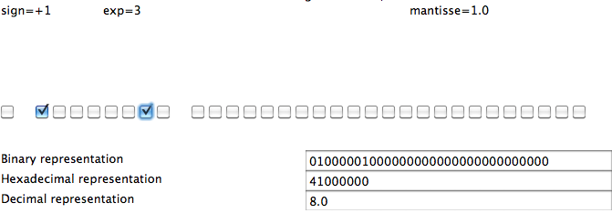
Representing 8.0
[http://www.h-schmidt.net/FloatApplet/IEEE754.html]

Slide 22
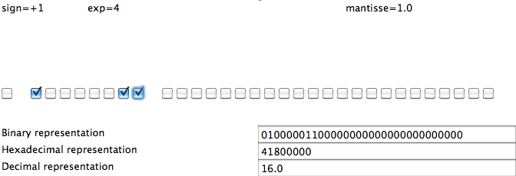
Representing 16.0
[http://www.h-schmidt.net/FloatApplet/IEEE754.html]

Slide 23
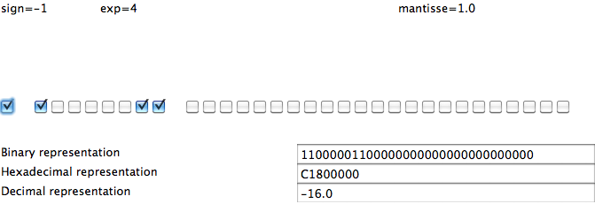
Representing -16.0
[http://www.h-schmidt.net/FloatApplet/IEEE754.html]

Slide 24
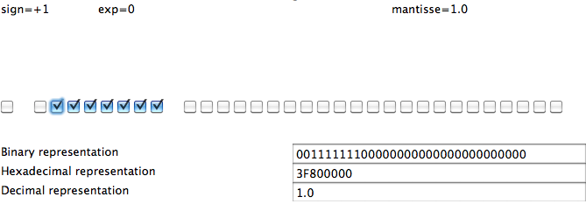
Representing 1.0
[http://www.h-schmidt.net/FloatApplet/IEEE754.html]

Slide 25
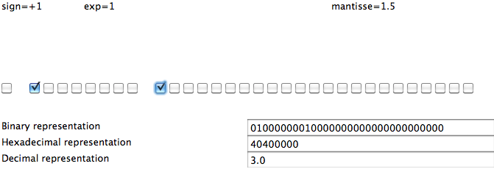
Representing 3.0
[http://www.h-schmidt.net/FloatApplet/IEEE754.html]

Slide 26
Representing 3.0
0
128
0.5
[http://www.h-schmidt.net/FloatApplet/IEEE754.html]

Slide 27
Representing 3.0
(-1)⁰
×
2⁽¹²⁸⁻¹²⁷⁾
×
(1 + 0.5)
= 3.0
[http://www.h-schmidt.net/FloatApplet/IEEE754.html]

Slide 28
Representing 3.0
1
×
2¹
×
1.5
= 3.0
[http://www.h-schmidt.net/FloatApplet/IEEE754.html]

Slide 30
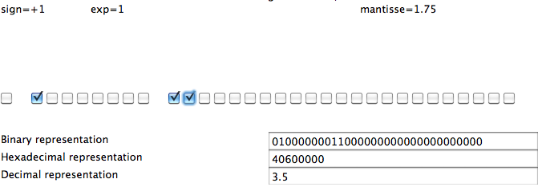
Representing 3.5
[http://www.h-schmidt.net/FloatApplet/IEEE754.html]

Slide 31
Representing 3.5
0
128
0.5 + 0.25
[http://www.h-schmidt.net/FloatApplet/IEEE754.html]

Slide 32
Representing 3.5
(-1)⁰
×
2⁽¹²⁸⁻¹²⁷⁾
×
(1 + 0.5 + 0.25)
= 3.5
[http://www.h-schmidt.net/FloatApplet/IEEE754.html]

Slide 33
Representing 3.5
1
×
2¹
×
1.75
= 3.5
[http://www.h-schmidt.net/FloatApplet/IEEE754.html]

Slide 35
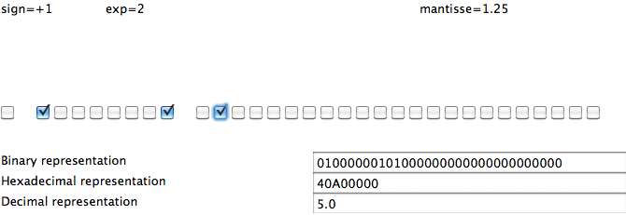
Representing 5.0
[http://www.h-schmidt.net/FloatApplet/IEEE754.html]

Slide 36
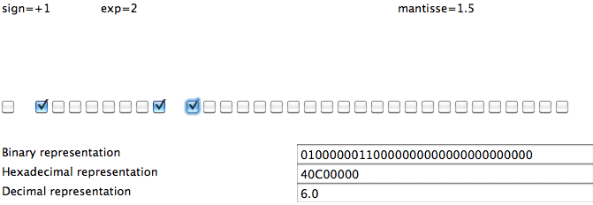
Representing 6.0
[http://www.h-schmidt.net/FloatApplet/IEEE754.html]

Slide 37
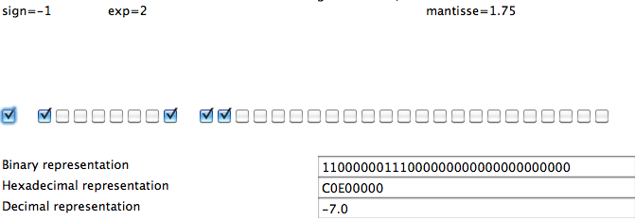
Representing -7.0
[http://www.h-schmidt.net/FloatApplet/IEEE754.html]

Slide 38
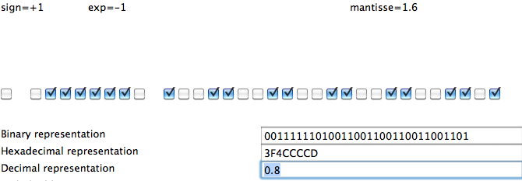
Representing 0.8
[http://www.h-schmidt.net/FloatApplet/IEEE754.html]

Slide 39
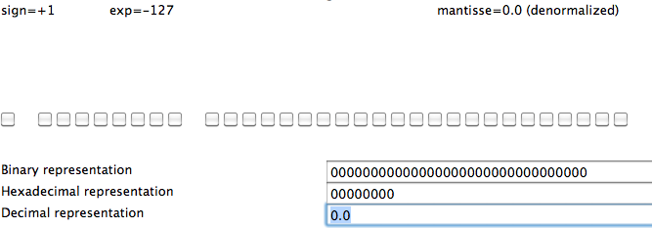
Representing 0.0
[http://www.h-schmidt.net/FloatApplet/IEEE754.html]

Slide 40
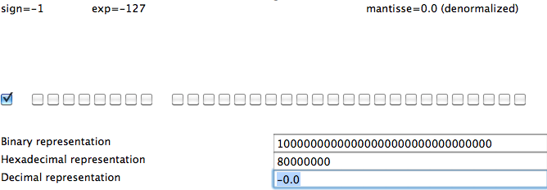
Representing -0.0
[http://www.h-schmidt.net/FloatApplet/IEEE754.html]

Slide 41
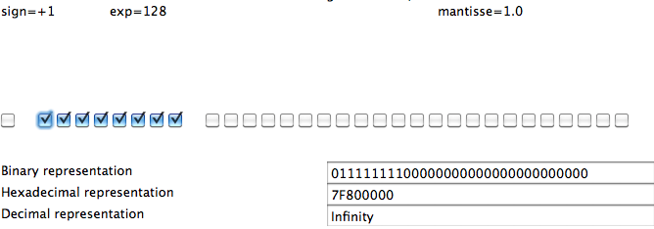
Representing +Infinity
[http://www.h-schmidt.net/FloatApplet/IEEE754.html]

Slide 42
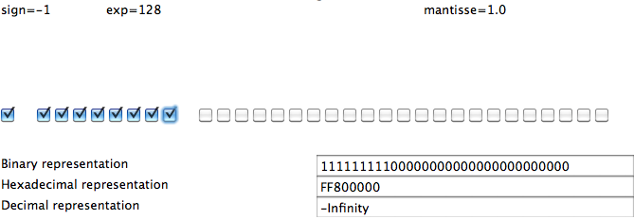
Representing -Infinity
[http://www.h-schmidt.net/FloatApplet/IEEE754.html]

Slide 43
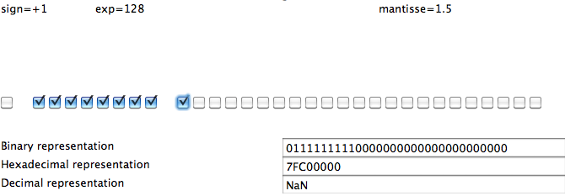
Representing NaN
[http://www.h-schmidt.net/FloatApplet/IEEE754.html]

Slide 44
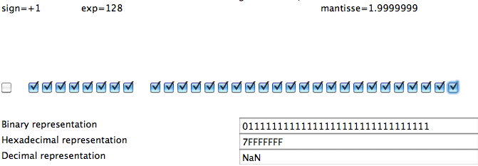
Representing NaN
[http://www.h-schmidt.net/FloatApplet/IEEE754.html]

Slide 45
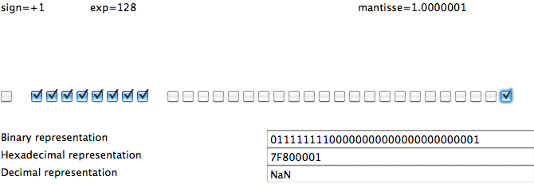
Representing NaN
[http://www.h-schmidt.net/FloatApplet/IEEE754.html]

Slide 46
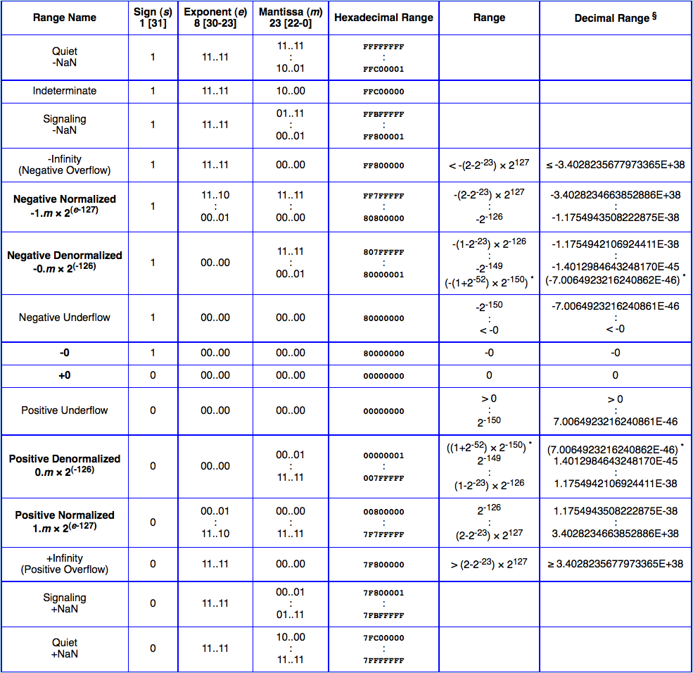
[http://babbage.cs.qc.cuny.edu/IEEE-754.old/References.xhtml]

Slide 47
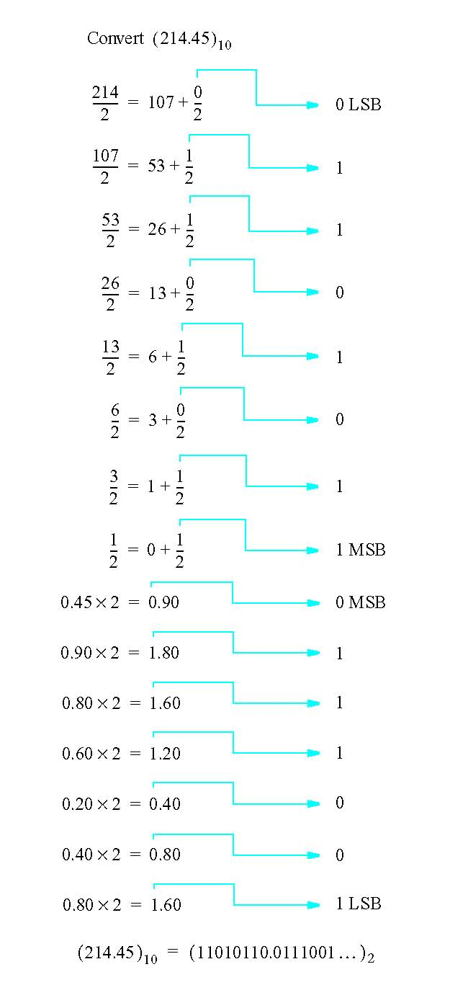
Conversion of fixed point numbers from decimal to binary
[Figure 3.44 from the textbook]

Slide 48

Memory Analogy
Address 0
Address 1
Address 2
Address 3
Address 4
Address 5
Address 6

Slide 49
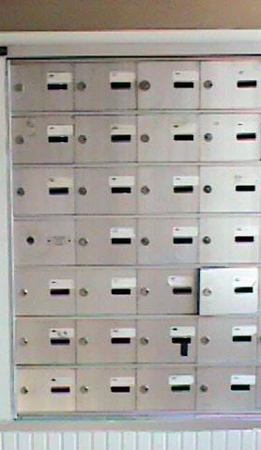
Memory Analogy (32 bit architecture)
Address 0
Address 4
Address 8
Address 12
Address 16
Address 20
Address 24

Slide 50
Memory Analogy (32 bit architecture)
Address 0x00
Address 0x0A
Address 0x04
Address 0x08
Address 0x0C
Address 0x10
Address 0x14
Address 0x0D
Address 0x18
Hexadecimal

Slide 51
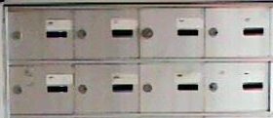
Storing a Double
Address 0x08
Address 0x0C

Slide 52
Storing 3.14
3.14 in binary IEEE-754 double precision (64 bits)
sign exponent mantissa
0 10000000000 1001000111101011100001010001111010111000010100011111
In hexadecimal this is (hint: groups of four):
0100 0000 0000 1001 0001 1110 1011 1000 0101 0001 1110 1011 1000 0101 0001 1111
4 0 0 9 1 E B 8 5 1 E B 8 5 1 F

Slide 53
Storing 3.14
So 3.14 in hexadecimal IEEE-754 is 40091EB851EB851F
This is 64 bits.
On a 32 bit architecture there are 2 ways to store this
Small address: 40091EB8 51EB851F
Large address: 51EB851F 40091EB8
Big-Endian
Little-Endian
Example CPUs:
Motorola 6800
Intel x86

Slide 54
Storing 3.14
Address 0x08
40 09 1E B8
Big-Endian
51 EB 85 1F
Address 0x0C
Address 0x08
51 EB 85 1F
Little-Endian
40 09 1E B8
Address 0x0C

Slide 55
Storing 3.14 on a Little-Endian Machine
(these are the actual bits that are stored)
Address 0x08
01010001 11101011 10000101 00011111
Address 0x0C
01000000 00001001 00011110 10111000
Once again, 3.14 in IEEE-754 double precision is:
sign exponent mantissa
0 10000000000 1001000111101011100001010001111010111000010100011111

Slide 56
They are stored in binary
(the hexadecimals are just for visualization)
5 1 E B 8 5 1 F
Address 0x08
01010001 11101011 10000101 00011111
4 0 0 9 1 E B 8
Address 0x0C
01000000 00001001 00011110 10111000

Slide 57
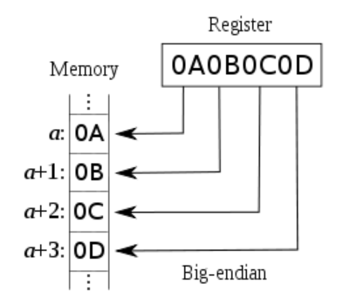
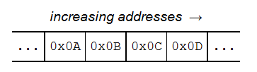

Big-Endian
(8-bit architecture)
(16-bit architecture)
http://en.wikipedia.org/wiki/Endianness

Slide 58
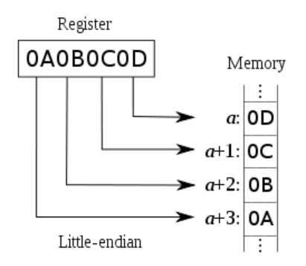


Little Endian
(8-bit architecture)
(16-bit architecture)
http://en.wikipedia.org/wiki/Endianness

Slide 59
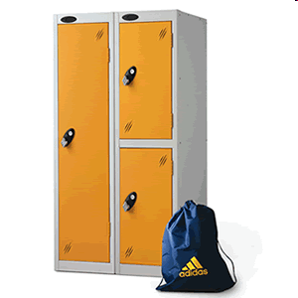
Big-Endian/Little-Endian analogy
[image fom http://www.simplylockers.co.uk/images/PLowLocker.gif]

Slide 60

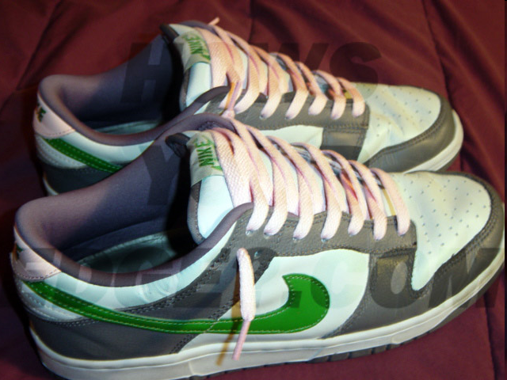
Big-Endian/Little-Endian analogy
[image fom http://www.simplylockers.co.uk/images/PLowLocker.gif]

Slide 61
Big-Endian/Little-Endian analogy
[image fom http://www.simplylockers.co.uk/images/PLowLocker.gif]

Slide 62
What would be printed?
(don’t try this at home)
double pi = 3.14;
printf(“%d”,pi);
Result: 1374389535
Why?
  3.14 = 40091EB851EB851F (in double format)
  Stored on a little-endian 32-bit architecture
    51EB851F (1374389535 in decimal)
    40091EB8 (1074339512 in decimal)

Slide 63
What would be printed?
(don’t try this at home)
double pi = 3.14;
printf(“%d %d”, pi);
Result: 1374389535 1074339512
Why?
  3.14 = 40091EB851EB851F (in double format)
  Stored on a little-endian 32-bit architecture
    51EB851F (1374389535 in decimal)
    40091EB8 (1074339512 in decimal)
    The second %d uses the extra bytes of pi that were not printed by the first %d

Slide 64
What would be printed?
(don’t try this at home)
double a = 2.0;
printf(“%d”,a);
Result: 0
Why?
  2.0 = 40000000 00000000 (in hex IEEE double format)
  Stored on a little-endian 32-bit architecture
    00000000 (0 in decimal)
    40000000 (1073741824 in decimal)

Slide 65
What would be printed?
(an even more advanced example)
int a[2]; // defines an int array
a[0]=0;
a[1]=0;
scanf(“%lf”, &a[0]); // read 64 bits into 32 bits
// The user enters 3.14
printf(“%d %d”, a[0], a[1]);
Result: 1374389535 1074339512
Why?
  3.14 = 40091EB851EB851F (in double format)
  Stored on a little-endian 32-bit architecture
    51EB851F (1374389535 in decimal)
    40091EB8 (1074339512 in decimal)
  The double 3.14 requires 64 bits which are stored in the two consecutive 32-bit integers named a[0] and a[1]

Slide 66
Questions?

Slide 67
THE END

